Slide 1



WIZELINE
D.E. Capstone Project
Camilo Andrés Martínez Vargas

Slide 2
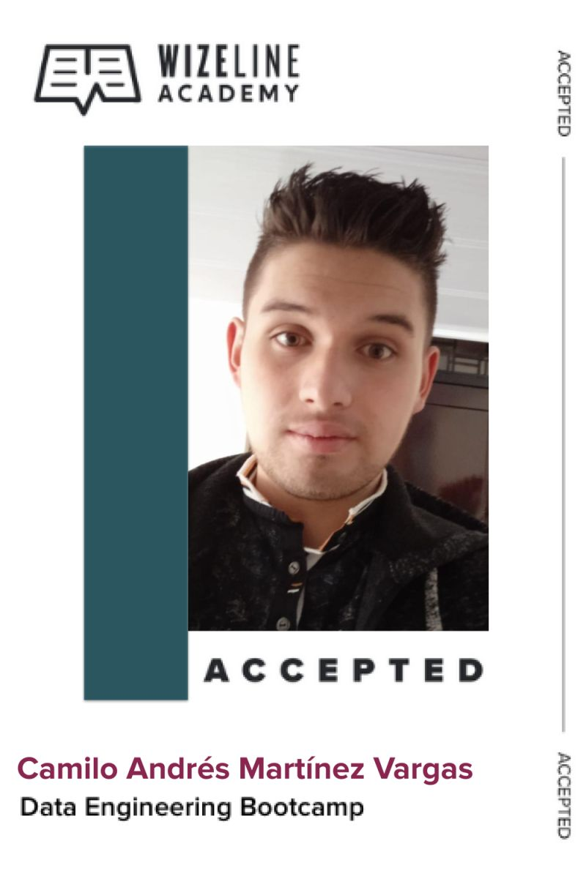

Camilo Martínez
Data Scientist (prior experience Data Engineer)
BSc in Mathematics
Data world, languages and programming enthusiastic

Slide 3
Table of Contents
I. Motivation
II. Problem Description
III. Solution Proposal
IV. Blockers and Lessons Learned
V. Q&A

Slide 4

Motivation
Get a better understanding of the concepts and world of data engineering
Work on a D.E. Project in order to put in practice my knowledge
Getting used to working with cloud services following best practices
Challenge myself and personal growth

Slide 5
Table of Contents
I. Motivation
II. Problem Description
III. Solution Proposal
IV. Blockers and Lessons Learned
V. Q&A

Slide 6

Problem Description
A user behavior analytics company wants to start getting business insights from their customer purchases and movie reviews data.
So, they need a D.E. capable of design and implement a Data Warehouse architecture for fast and easy to understand queries with cloud services.

Slide 7
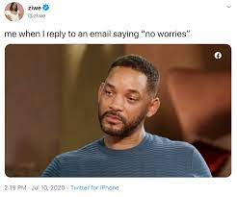
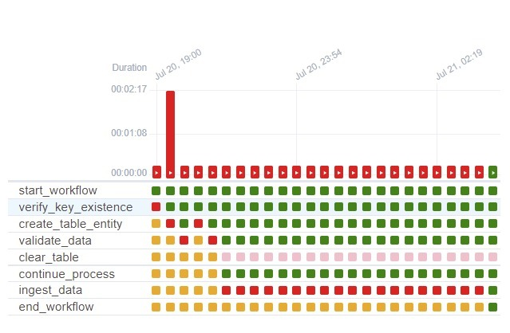
Challenges Found
Using airflow for the workflow orchestration
Design DW schema
Manage IAM roles and secrets for a more secure workflow

Slide 8
Table of Contents
I. Motivation
II. Problem Description
III. Solution Proposal
IV. Blockers and Lessons Learned
V. Q&A

Slide 9

Customer Agreements and Clarifications
Customer
Data workflow is going to be manage on batch
Only identifiable customers’ reviews are going to be consider (data anomalies)
Purchases returns are going to be omitted
All duplicated data is going to be dropped

Slide 10






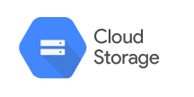
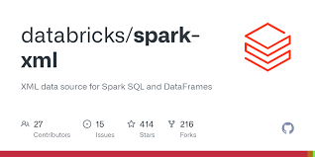







Tools and Services Used
Notes:
No gastar mucho tiempo en esta

Slide 11
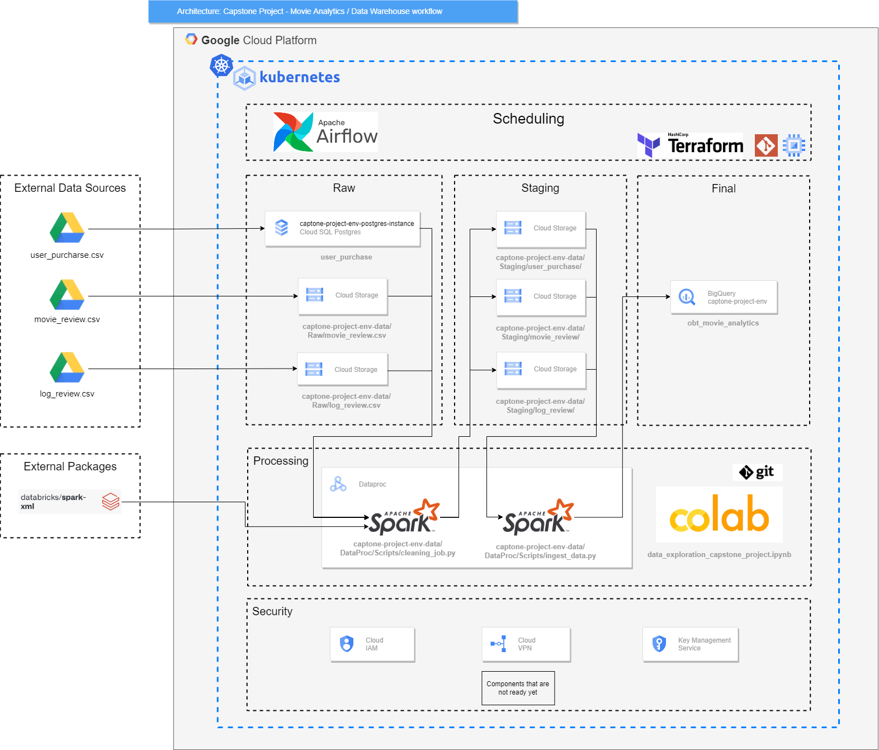
Architecture Design

Slide 12
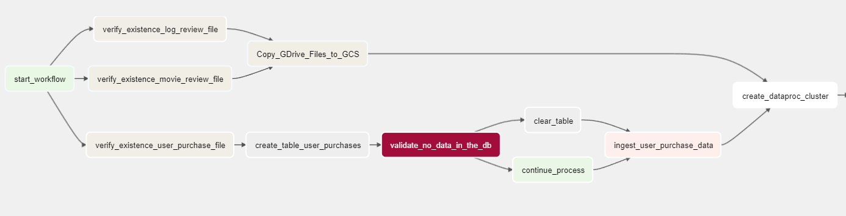
DAG Workflow Part I

Slide 13
Architecture Design

Slide 14
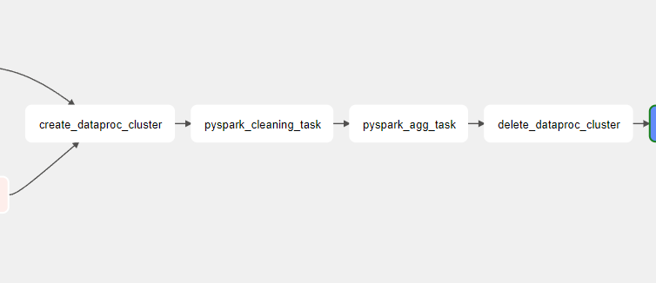
DAG Workflow Part II

Slide 15
Architecture Design

Slide 16
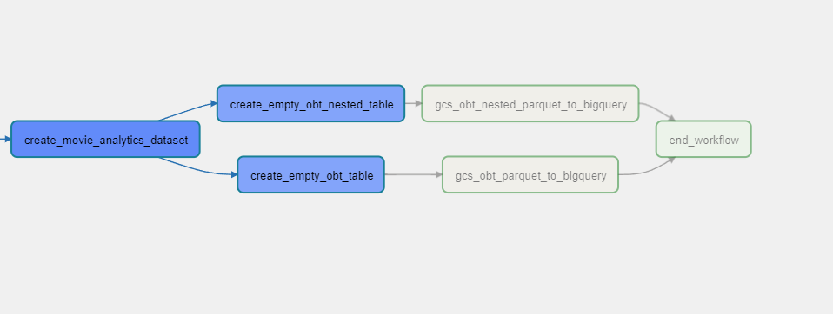
DAG Workflow Part III

Slide 17
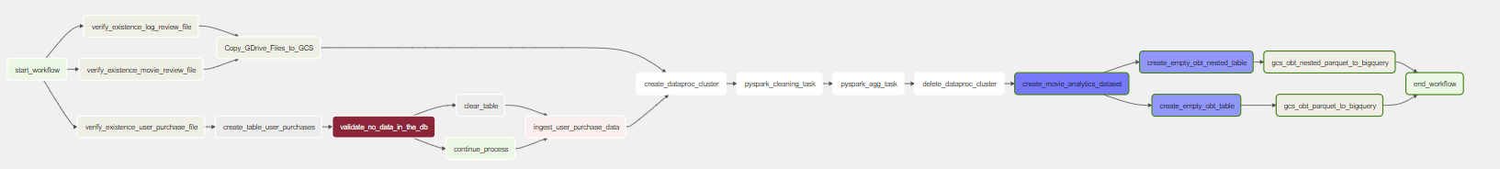
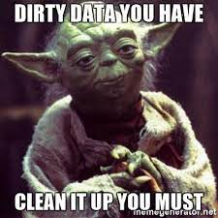
DAG Complete Workflow

Slide 18
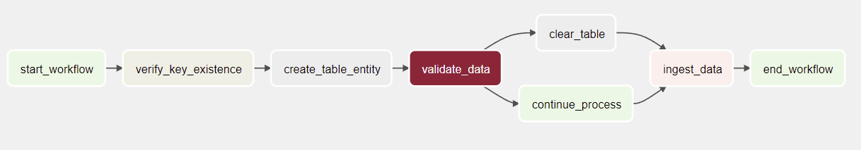
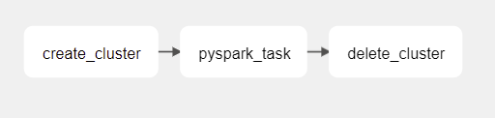
Workflow (Airflow DAG Sequence will be added)
Load Raw data to GCS
Clean Raw data and load it to Staging zone
Aggregate Staging zone data to load it to the DW (In process)

Slide 19
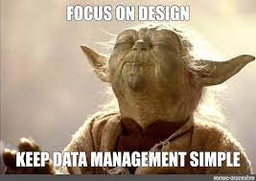
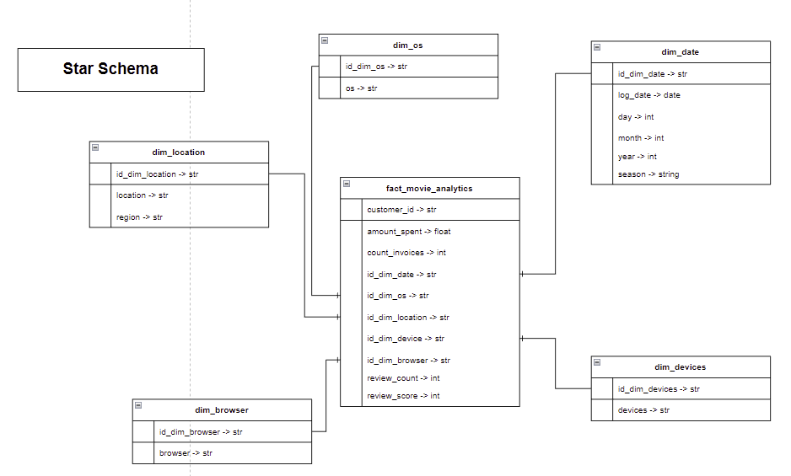
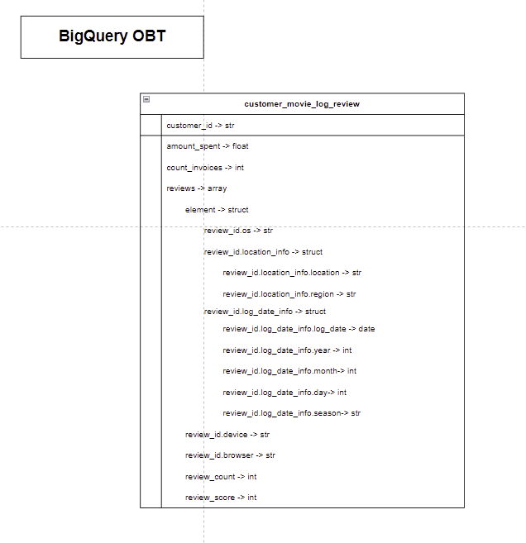
Data Warehouse Schema

Slide 20
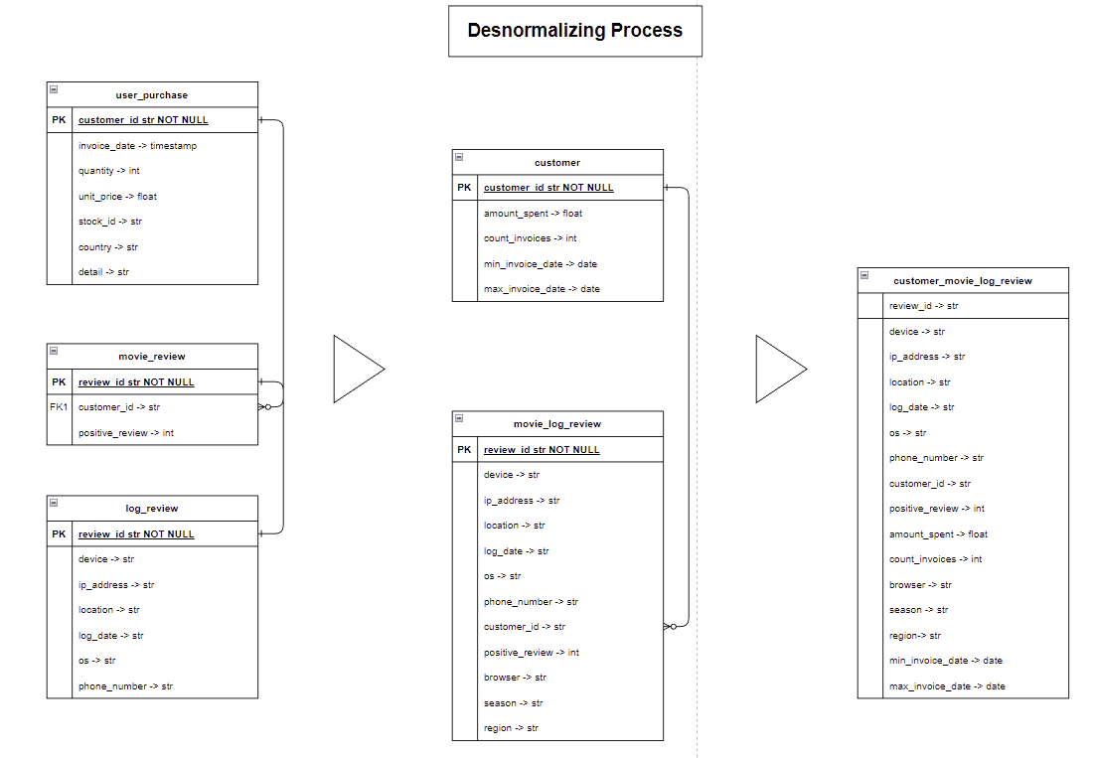

Data Warehouse Schema

Slide 21
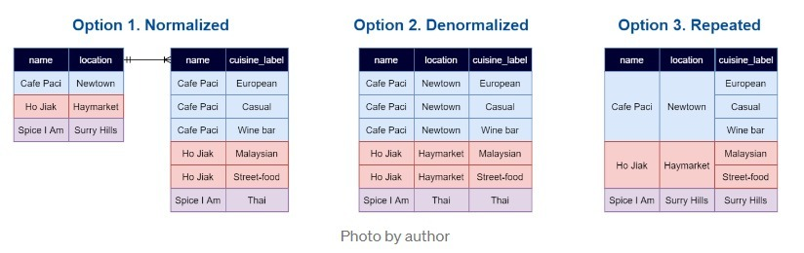
Data Warehouse Schema (OBT example)

Slide 22
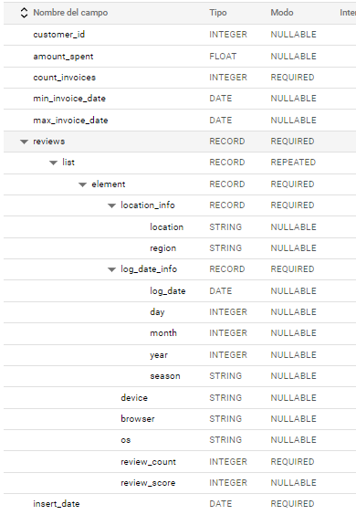
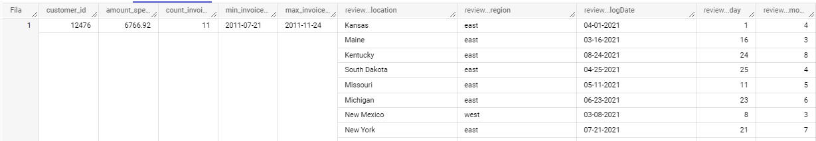
Data Warehouse Schema

Slide 23
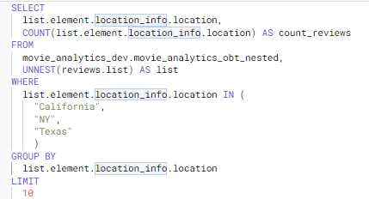
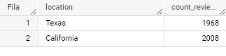
Project Questions
How many reviews were done in California, NY and Texas?

Slide 24
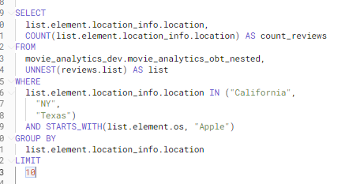
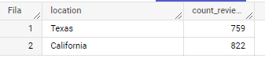
Project Questions
How many reviews were done in California, NY, and Texas with an apple device? And how many for each device type?

Slide 25
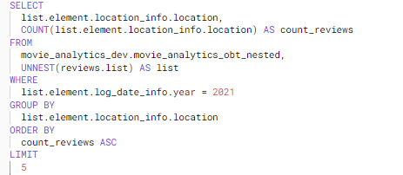
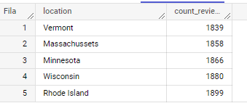
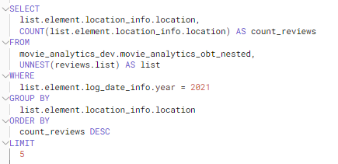
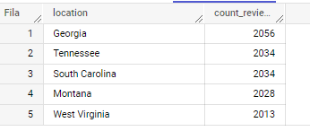
Project Questions
What are the states with more and fewer reviews in 2021?

Slide 26
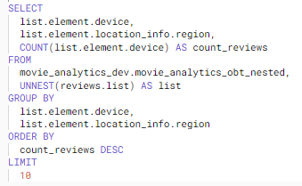
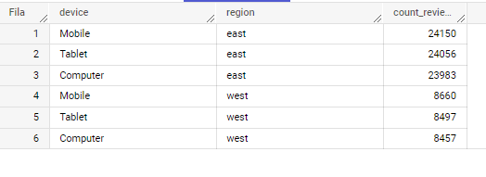
Project Questions
Which device is the most used to write reviews in the east and which one in the west?

Slide 27
Project Questions

Slide 28
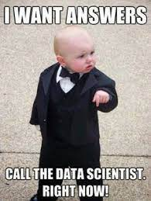
Final Questions’ Answers
How many reviews were done in California, NY and Texas?
How many reviews were done in California, NY, and Texas with an apple device? And how many for each device type?
What are the states with more and fewer reviews in 2021?
Which device is the most used to write reviews in the east and which one in the west?

Slide 29
Table of Contents
I. Motivation
II. Problem Description
III. Solution Proposal
IV. Blockers and Lessons Learned
V. Q&A

Slide 30

Blockers and Lessons Learned
Next Steps
Lessons Learned
IAM roles and secrets
Business insights with Data Studio
ML model for review tagging
CI / CD for python script use by DataProc
Data quality logging steps in airflow
Architecture diagram as code
Write down your thoughts before coding
DataProc clusters can be deploy within airflow, but there isn’t too much documentation about it
OBT schema is a better approach when working with columnar storage DW like BigQuery
Capstone Project Link

Slide 31
Table of Contents
I. Motivation
II. Problem Description
III. Solution Proposal
IV. Blockers and Lessons Learned
V. Q&A

Slide 32
Q&A

Slide 33
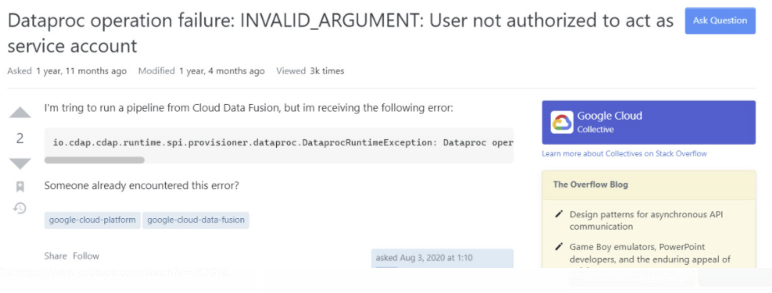
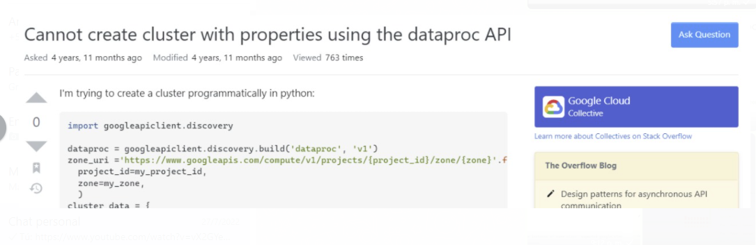
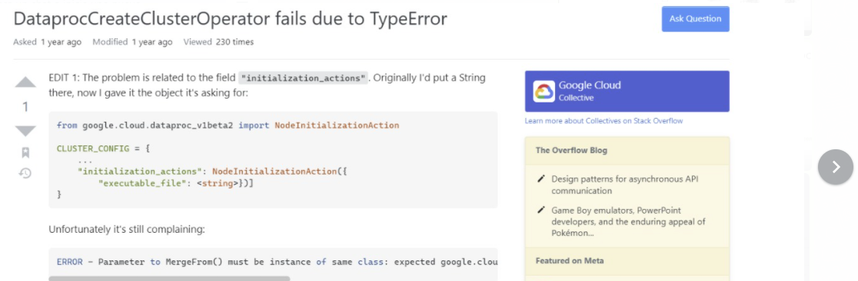
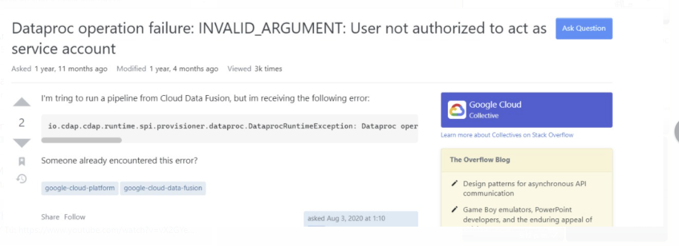
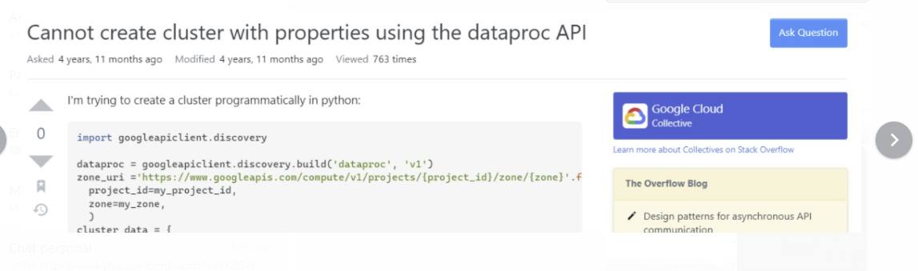

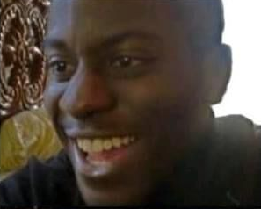




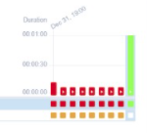
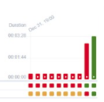
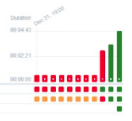
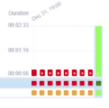
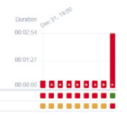
Dark Time Example (Timeline spark-xml package installation)
Notes:
Demasiadas imagenes

Slide 34
Thanks!

Slide 35
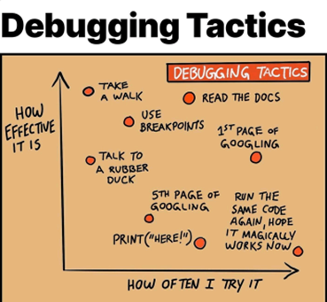
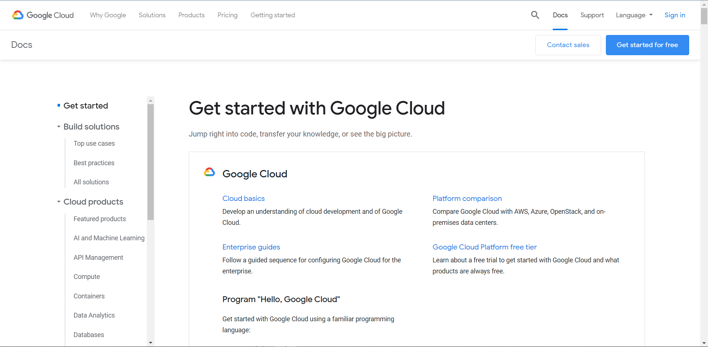
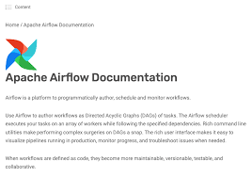
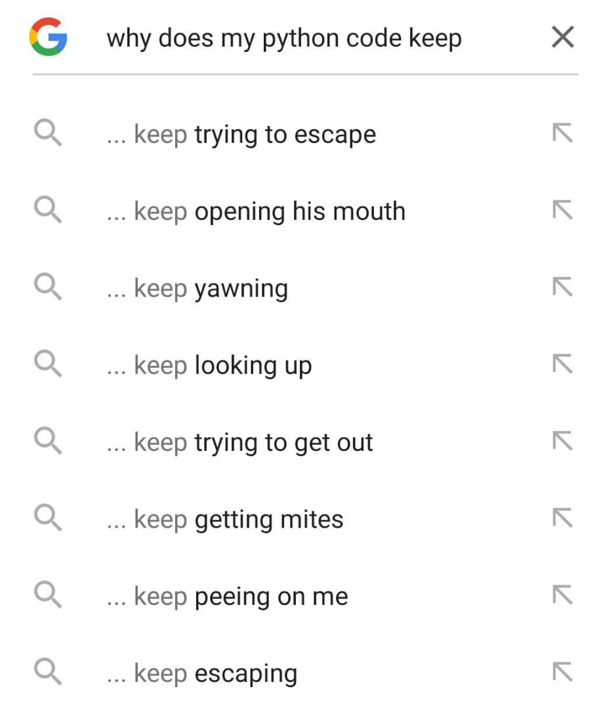
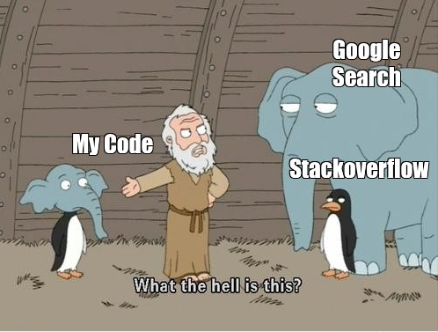



Help in dark times

